Slide 1
One Shot Learning
Arindam Shrivastava
21075015
Madhavendra Rathore
21075051

Slide 2
Introduction
One Shot Learning is a machine learning approach where a model is trained to recognize objects or patterns from few examples.
A traditional Machine learning models requires large amount of labeled data for training while One Shot Learning models learn from very few examples.
These models are required where obtaining large amounts of labeled data is very difficult, for example in biometric recognition.

Slide 3
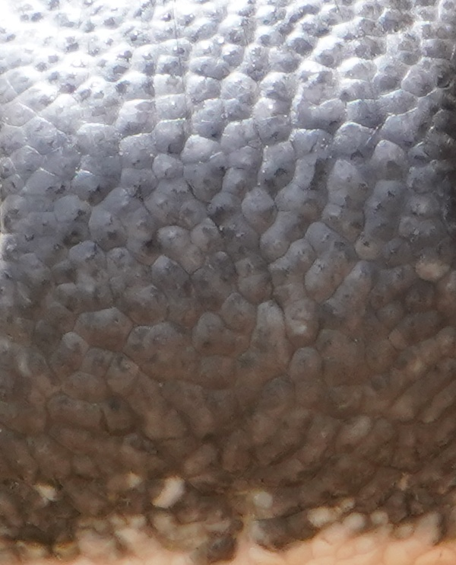
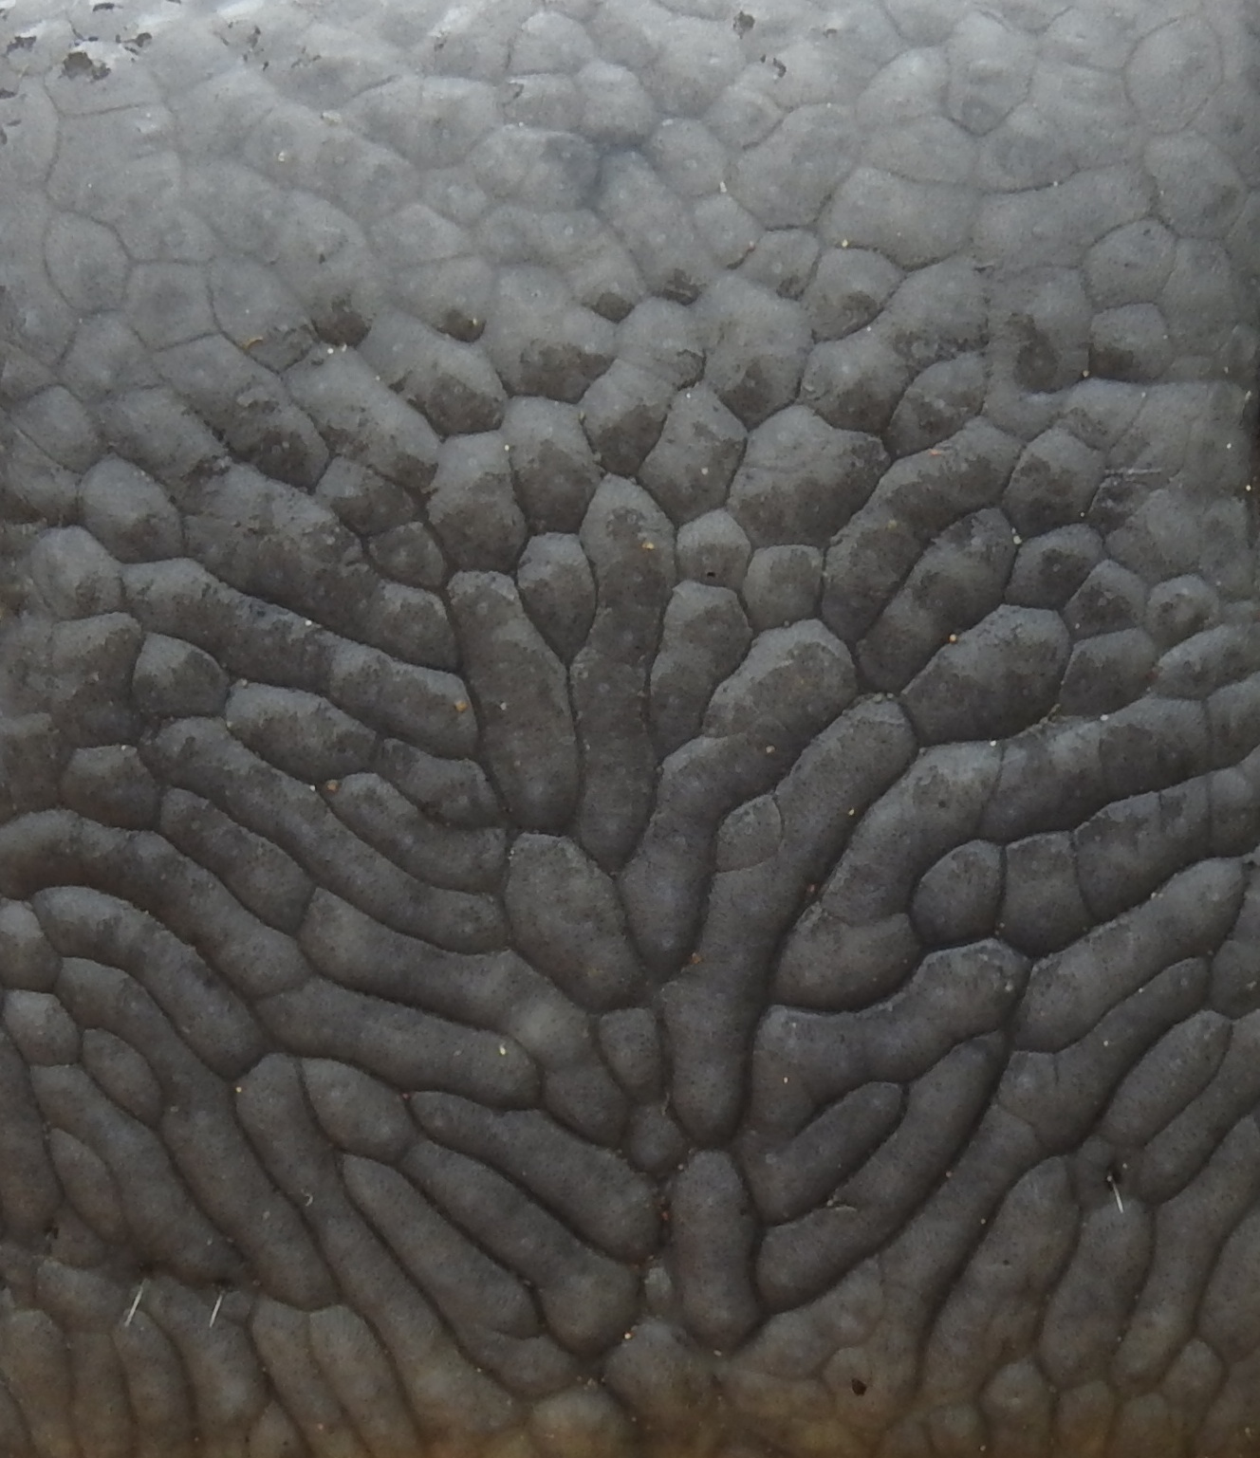
Dataset
The dataset we used is a set of images of cattle muzzles.
The muzzle print of each animal is different from others as is in case of human fingerprints.
For each of the animals, there are 10 images of their muzzle print in the dataset.
Further there are different classes in training and testing/validation data.

Slide 4
Preprocessing
The data is first passed through a pre-trained SRGAN, to super resolution the image so that the features of the image become more distinct.
The number of images in each class is set to 10, so as to make the training process of the model easier and shorter.
The super resolution data is then packed into pickle files along with the class names which are one-hot encoded to be used for training the one shot model.

Slide 5
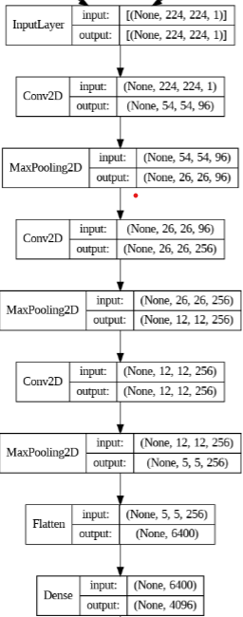
Model
The One Shot Model for image recognition consists of two parts.
The Convolutional Network
The Discriminator
The two images are passed through the same Convolutional Network to get two feature vectors corresponding to each image.
The ConvNet

Slide 6
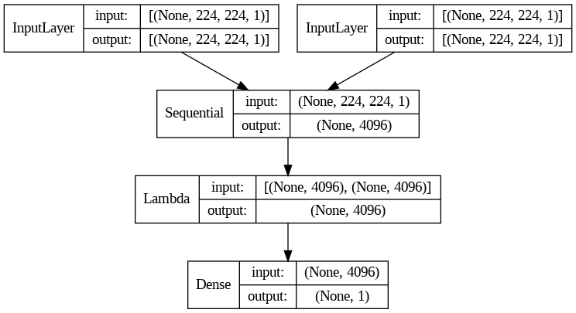
Model
The Discriminator then using the feature vectors calculates the L1 Distance (Absolute Difference) between the vectors and uses a sigmoid layer to output the similarity between the vectors
The One Shot Model

Slide 7
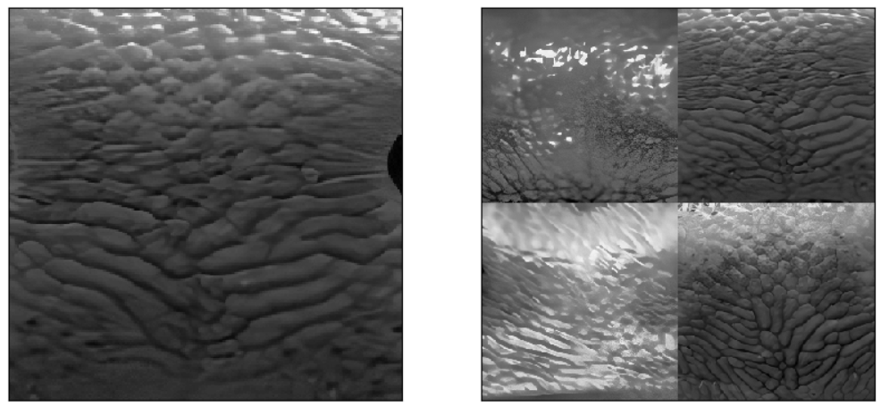
One Shot Task
The model is given data in form of a One Shot Task. The one shot task consists of a pair of image and support set.
The image is the image that we use to train.
The support set consists of N images out of which 1 image is of same class as the training image while others are of different classes.
The goal of the model is to give maximum similarity score to the image of the same class as training image
One Shot Task
(N = 4)

Slide 8
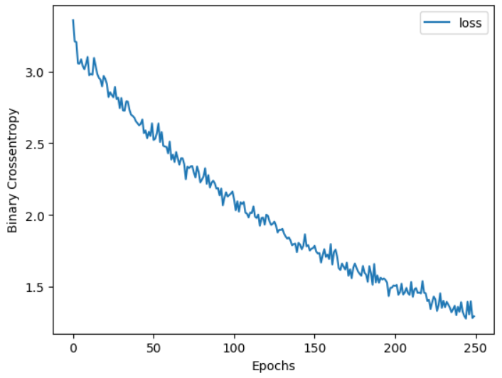
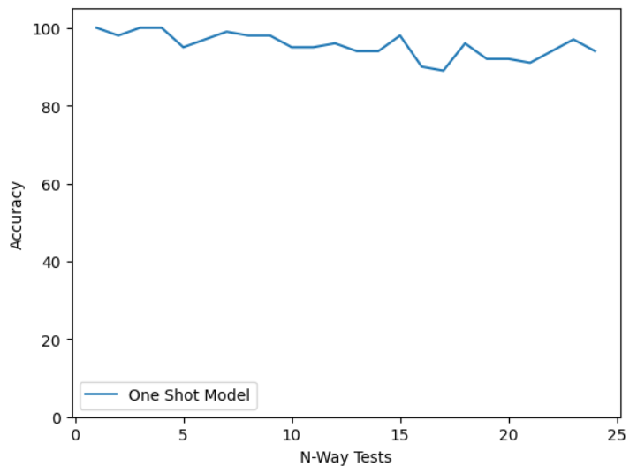
Results

